Slide 1


Minor Project on
Deepfake Detection

Slide 2
CONTENTS
01.
02.
03.
04.
INTRODUCTION
WORKING IDEA
PROGRESS
CONCLUSION

Slide 3

INTRODUCTION

Slide 4
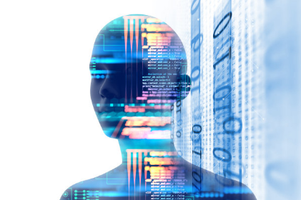
Deepfakes are synthetic media, typically videos or images, that have been manipulated using artificial intelligence (AI) to convincingly replace one person's likeness with another. They leverage machine learning techniques, particularly deep learning, to create highly realistic and believable forgeries.

Slide 5

WORKING IDEA

Slide 6
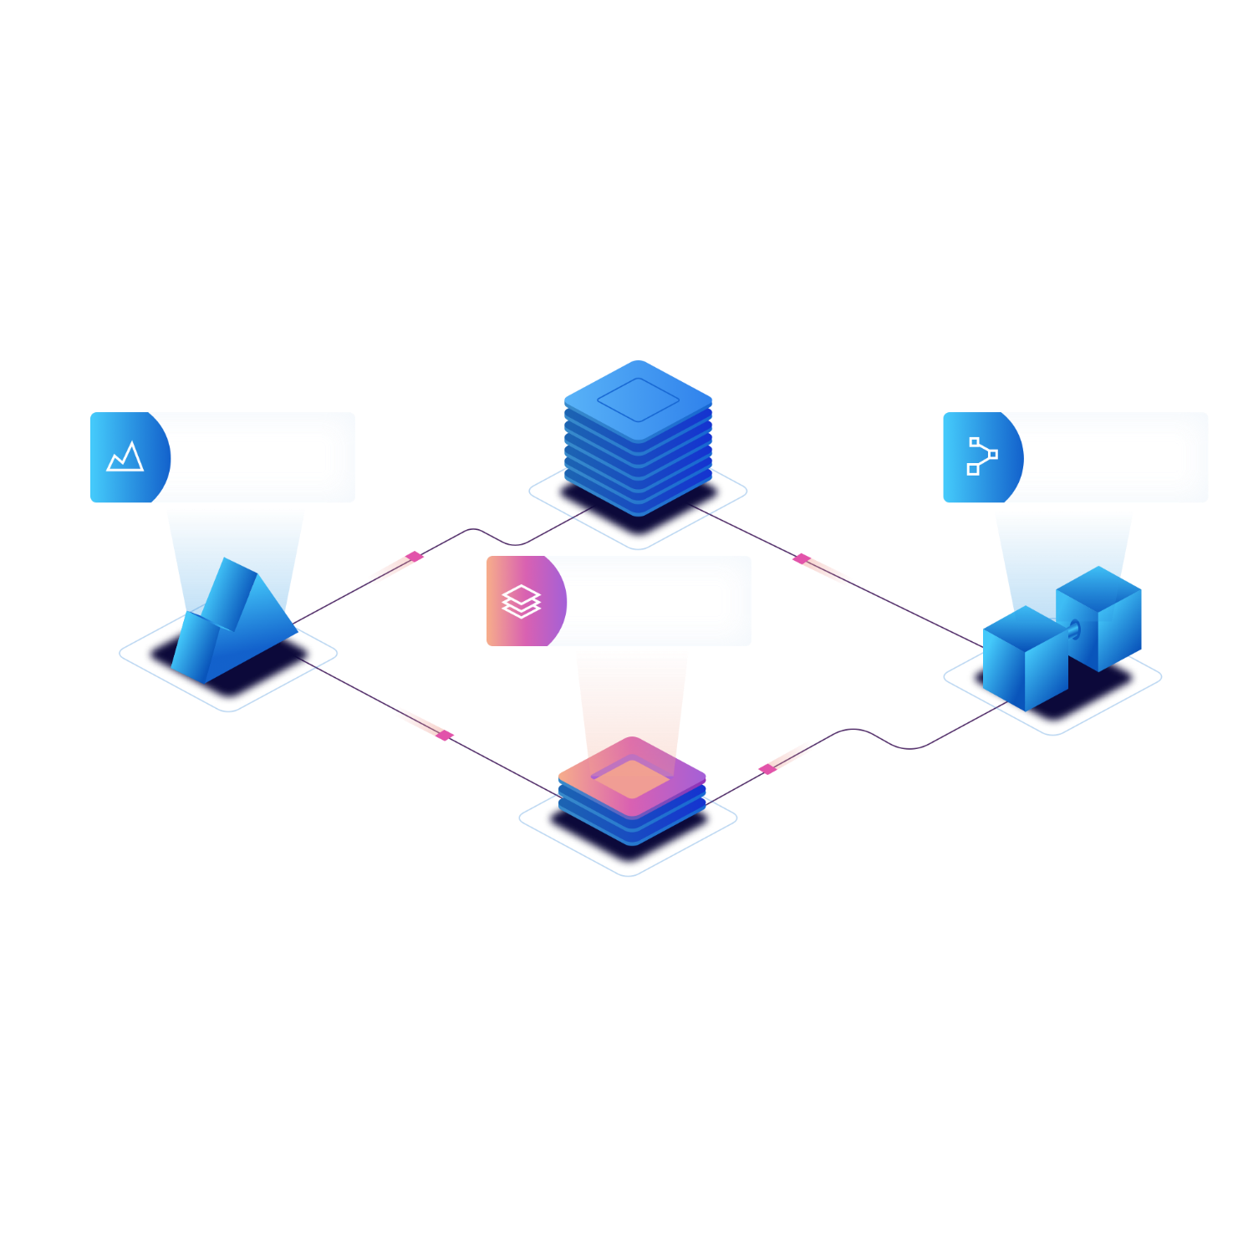
A
B
ORIGNAL
Unadulterated representation: An original video or image captures the actual event or person without any modifications.
Authentic details: Lighting, shadows, facial expressions, and movements are natural and consistent with the environment and person involved.
Verifiable source: Often originates from credible sources like news outlets, reliable social media accounts, or directly from the individuals involved.
DEEPFAKE
AI-manipulated content: Uses complex algorithms to superimpose one person's likeness onto another or create entirely fabricated situations.
Potential inconsistencies: While becoming increasingly realistic, deepfakes may exhibit subtle flaws in things like:
Lighting: Uneven or unnatural lighting around the superimposed person.
Skin tones: Mismatched skin tones between the face and neck or background.
Movement: Unnatural or jerky movements, particularly around the eyes
and mouth.
Potentially misleading: Aims to deceive the viewer into believing the depicted event or person is real when it's not.

Slide 7
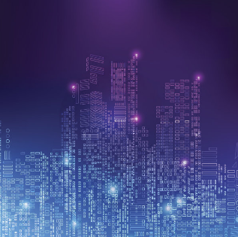
Tools
OpenCV: It is a tools for image and video analysis. It can be used for tasks such as face detection, facial landmark detection, and image manipulation, which are essential for identifying potential deepfakes.
dlib: dlib is a C++ library with Python bindings commonly used for computer vision tasks. It offers facial landmark detection and face alignment functionalities.
TensorFlow or PyTorch: Commonly used for building and training machine learning models, including those used for deepfake detection.
scikit-learn: Provides tools for data preprocessing, classification, and model evaluation.
face_recognition: face_recognition is a simple library for face recognition and manipulation tasks. It provides face detection, facial landmark detection, and face encoding functionalities, which can be useful for identifying manipulated faces in deepfake videos.

Slide 8
Data Set
Deepfake Detection Dataset (DFDC): The DFDC is one of the most widely used datasets for deepfake detection research. It contains thousands of videos with manipulated faces created using various deepfake techniques. The dataset includes both training and validation sets, each with real and fake video clips.
FaceForensics++: FaceForensics++ is another popular dataset for deepfake detection. It includes videos generated using four different manipulation methods: Deepfakes, Face2Face, FaceSwap, and NeuralTextures. The dataset provides a diverse set of manipulated videos along with corresponding original videos.
Deepfake Detection Challenge Dataset: The Deepfake Detection Challenge Dataset, released by Google in collaboration with Kaggle, was hosted on Kaggle during the Deepfake Detection Challenge. This dataset consists of a mix of real and manipulated videos and was used for a competition aimed at advancing deepfake detection techniques.

Slide 9
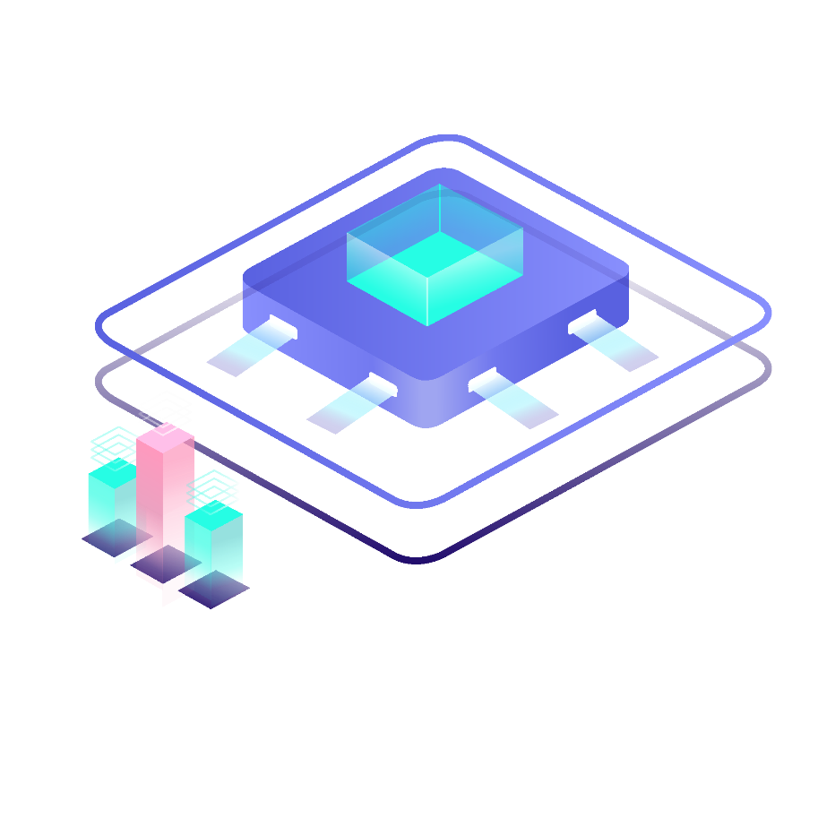
PROGRESS

Slide 10
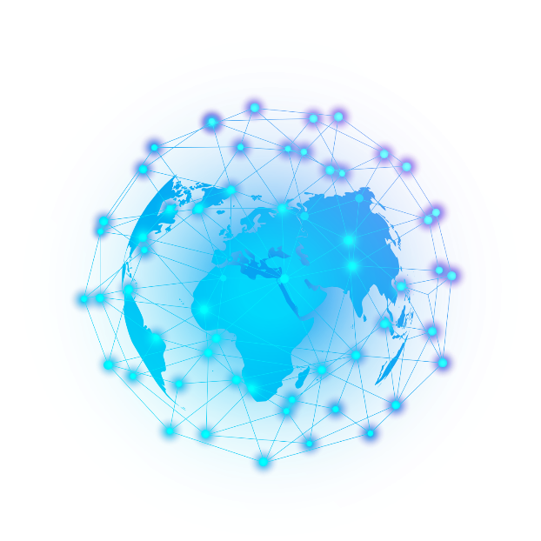
1. Case Study
Grasping the basic and advance knowleding of DeepFake with its advantages and disadvantages.
2. Material Gathering
Gathering materials on AI, Deepfake, Detection, Tools, Data Sets and solutions.
3. Group Discussion
Discussion on the topic and planning the coding phase.

Slide 11
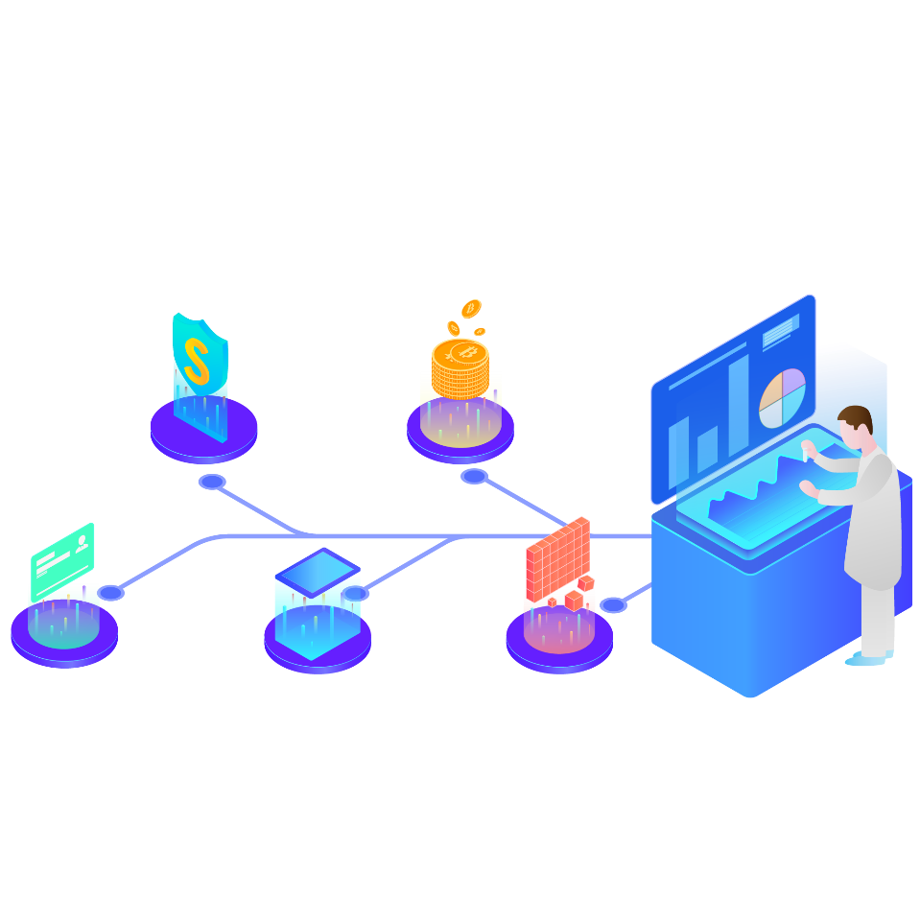
CONCLUSION

Slide 12
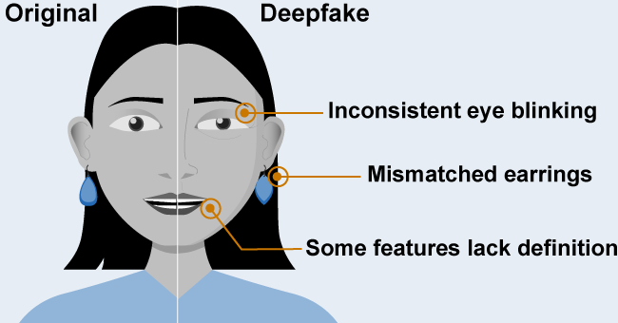
As deepfakes blur reality, Python shines as your truth-seeker. Tools like Mesonet and pre-trained models become your digital detectives, exposing subtle inconsistencies in faces and movements. DeepStar, your AI partner, delves deeper, analyzing patterns to unveil the fabricated. Remember, the fight against deception is continuous, so adapt your tools and stay informed. With Python, empower yourself to navigate the digital landscape with confidence, knowing you have the power to discern the real from the artfully false.

Slide 13
THANKS
Sanskar Shukla(21051247) Riya Singh(21052783) Siddhant Kumar(21052970)
Priyanshu Gupta(2105393) Kunal Kishore(21051060)

